Slide 1
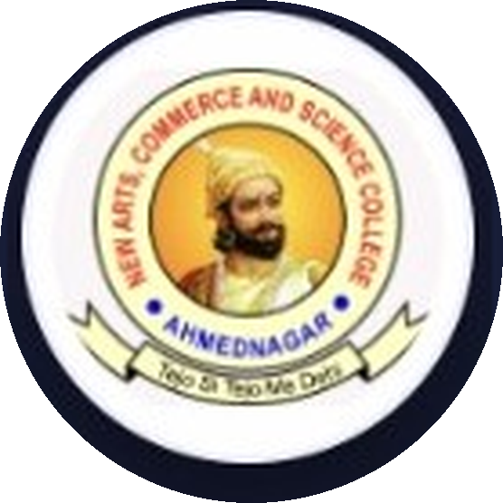

AHMEDNAGAR JILHA MARATHA VIDYA PRASARAK SAMAJ'S
New Arts, Commerce and Science College, Ahmednagar (Autonomous)
Center for Advanced Studies in Applied Sciences (CASAS) | Department of Computer Science
Dairy App
Dairy Management System
M.Sc. Computer Science II
Presented By: Bhandari Saurabh Ashok & Gayake Aditya Babasaheb Guided By: Prof. Bingare M. B. Madam Date: 19-08-2026

Slide 2



01 · Introduction
What is the Dairy Management System?
Digital Solution
Replaces Paper Records
Smooth Management
A comprehensive digital solution designed specifically for dairy businesses and farmers.
Replaces traditional paper-based record-keeping with a modern web application.
Facilitates smooth management of milk collection, daily rates, and farmer payments.
Dairy Management System
2

Slide 3



02 · Project Purpose
Why Are We Building This?
Digitize & Automate
Transparency & Trust
Fewer Errors
Digitize and automate daily dairy operations to achieve maximum efficiency.
Provide absolute transparency and trust between dairy owners and farmers.
Reduce manual calculation errors in billing and ledger management.
Dairy Management System
3

Slide 4



03 · Scope Statement
What Does This Project Cover?
Target Users
End-to-End Process
Current Exclusions
Designed specifically for local dairy cooperatives and independent farms.
Covers end-to-end processes: from milk collection to automated payment settlements.
Excludes physical hardware integration (e.g., weighing machines / fat testing machines) in the current phase.
Dairy Management System
4

Slide 5



04 · Definition of Scope
In-Scope vs Out-of-Scope
IN-SCOPE
OUT-OF-SCOPE
Web portal for Admin
Inventory management of cattle feed
Farmer profiles
Hardware integration
Dynamic Rate management
Native Mobile app (planned for future)
Billing & Ledger
Dynamic Reports
Dairy Management System
5

Slide 6




05 · Project Scope Management
How We Manage Scope
Requirements Gathering
Scope Definition
Scope Verification
Scope Control
Understanding the specific daily needs of local dairy operators.
Clearly outlining the specific software features to be built.
Regular feedback loops from potential users.
Preventing feature creep during the agile development cycle.
Dairy Management System
6

Slide 7



06 · Scope Planning
Development Phases
Phase 1
Phase 2
Phase 3
Phase 4
Requirement Analysis, Data Flow Diagrams & UI/UX Design
Database Design & Backend Setup (Supabase & Node.js)
Frontend Web Development (React.js) & API Integration
Testing, Bug Fixing, Security Audits, & Final Deployment
Dairy Management System
7

Slide 8
07 · Project Charter
Charter Overview
Project Name
Dairy Management System
Project Sponsors
New Arts, Commerce and Science College
Project Leads
Saurabh Bhandari, Aditya Gayake
Milestones
1
2
3
4
Design
Core Features
Beta Testing
Final Release
Dairy Management System
8

Slide 9



08 · Problem Statement
Challenges in Traditional Dairies
Manual Registers
Data Risk
No Real-Time Insight
Delayed Payments
Traditional dairies rely heavily on manual record-keeping via physical registers.
High risk of data loss, calculation errors, and data manipulation.
Lack of real-time insights into daily collection and farmer ledgers.
Delayed payment calculations leading to farmer dissatisfaction.
Dairy Management System
9

Slide 10

09 · Objectives
What We Aim to Achieve
Secure & Cloud-Based
Automated Rates
Instant Reports
User-Friendly UI
Develop a highly secure, cloud-based Dairy Management System.
Automate complex milk rate calculations based on FAT and SNF parameters.
Generate accurate billing and detailed ledger reports instantly.
Provide a responsive, user-friendly interface for dairy owners.
Dairy Management System
10

Slide 11
10 · System Comparison
Existing System vs Proposed System
EXISTING SYSTEM
PROPOSED SYSTEM
Paper-based registers
Web-based Dashboard
Manual rate calculations
Automated rate charts
Tedious to find historical records
Searchable digital ledgers
Minimal data security
Secure cloud data storage
Dairy Management System
11

Slide 12



11 · Technology Stack
Tools & Technologies Used
Frontend
Backend
Database
Security
Deployment
React.js
Tailwind CSS
(Responsive UI)
Node.js
Express.js
(REST API)
Supabase
PostgreSQL
(Relational Data)
JWT Authentication
Role-based Access
Netlify
Vercel
Dairy Management System
12

Slide 13

12 · System Modules
Core Application Modules
Authentication
Admin Dashboard
Farmer Management
Milk Collection
Login & Registration
Analytics overview
Farmer profiles & records
Daily collection entry
Rate Charts
Payments
Ledger
Reporting
Dynamic milk rate charts
Payments & settlements
Ledger & ledger history
Reporting & export
Dairy Management System
13

Slide 14

13 · Database Design
Entity Relationship Overview
Comprehensive Entity-Relationship diagram designed for scale and integrity.
Maintains strict One-to-Many relationships ensuring data consistency.
Milk Collection
Daily Rate
Users
Payments
Farmers
Settlements
Dairy Management System
14

Slide 15

14 · System Architecture
3-Tier Architecture
Client Tier
React Browser Application (Fast & Responsive)
Middle Tier
Node.js / Express.js RESTful API (Secure & Scalable)
Data Tier
Supabase PostgreSQL Database (Robust cloud storage)
Dairy Management System
15

Slide 16
15 · Core Features
What the System Can Do
Fast Milk Collection Entry
Dynamic Daily Rate Charts
Real-time Ledger Updates
Automated Payment Management
Comprehensive Reports Export
Secure Role-Based Login
Dairy Management System
16

Slide 17

16 · System Benefits
Why It Matters
100% Paperless System
Faster Daily Operations
Secure Database Prevents Data Loss
Accurate Calculation & Billing Reports
Massive Time Savings for Owners
Dairy Management System
17

Slide 18





17 · Future Scope
What's Next
Native Android/iOS Application for Farmers
Barcode / QR Code Support for Farmer IDs
WhatsApp & SMS Notifications for daily receipts
Automated Cloud Backups
AI Analytics for Milk Yield Trends
Cattle Feed Inventory & Store System
Dairy Management System
18

Slide 19
CONCLUSION
Bridging Tradition and Technology
Modernizes Operations
Bridges the Gap
Efficiency & Trust
The system successfully modernizes traditional, manual dairy operations.
It bridges the massive gap between digital technology and the local agricultural sector.
Ensures maximum efficiency, transparency, and accuracy for all stakeholders.

Slide 20
Thank You!
Any Questions?
Bhandari Saurabh Ashok • Gayake Aditya Babasaheb
Guided By: Prof. Bingare M. B. Madam

